Slide 1
Content Objective: Students will write a story to introduce themselves & will be introduced to the Fourth Industrial Revolution.
Tuesday January 21st
Introduce Myself
Google Drive Folder / Write a Story
The Fourth Industrial Revolution
Homework
During projects only...

Slide 2





Introduction - Matt Turner
Artificial Intelligence Ethics Teacher

Slide 3
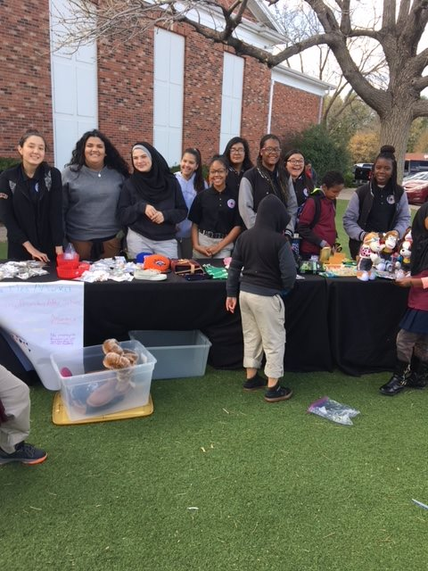
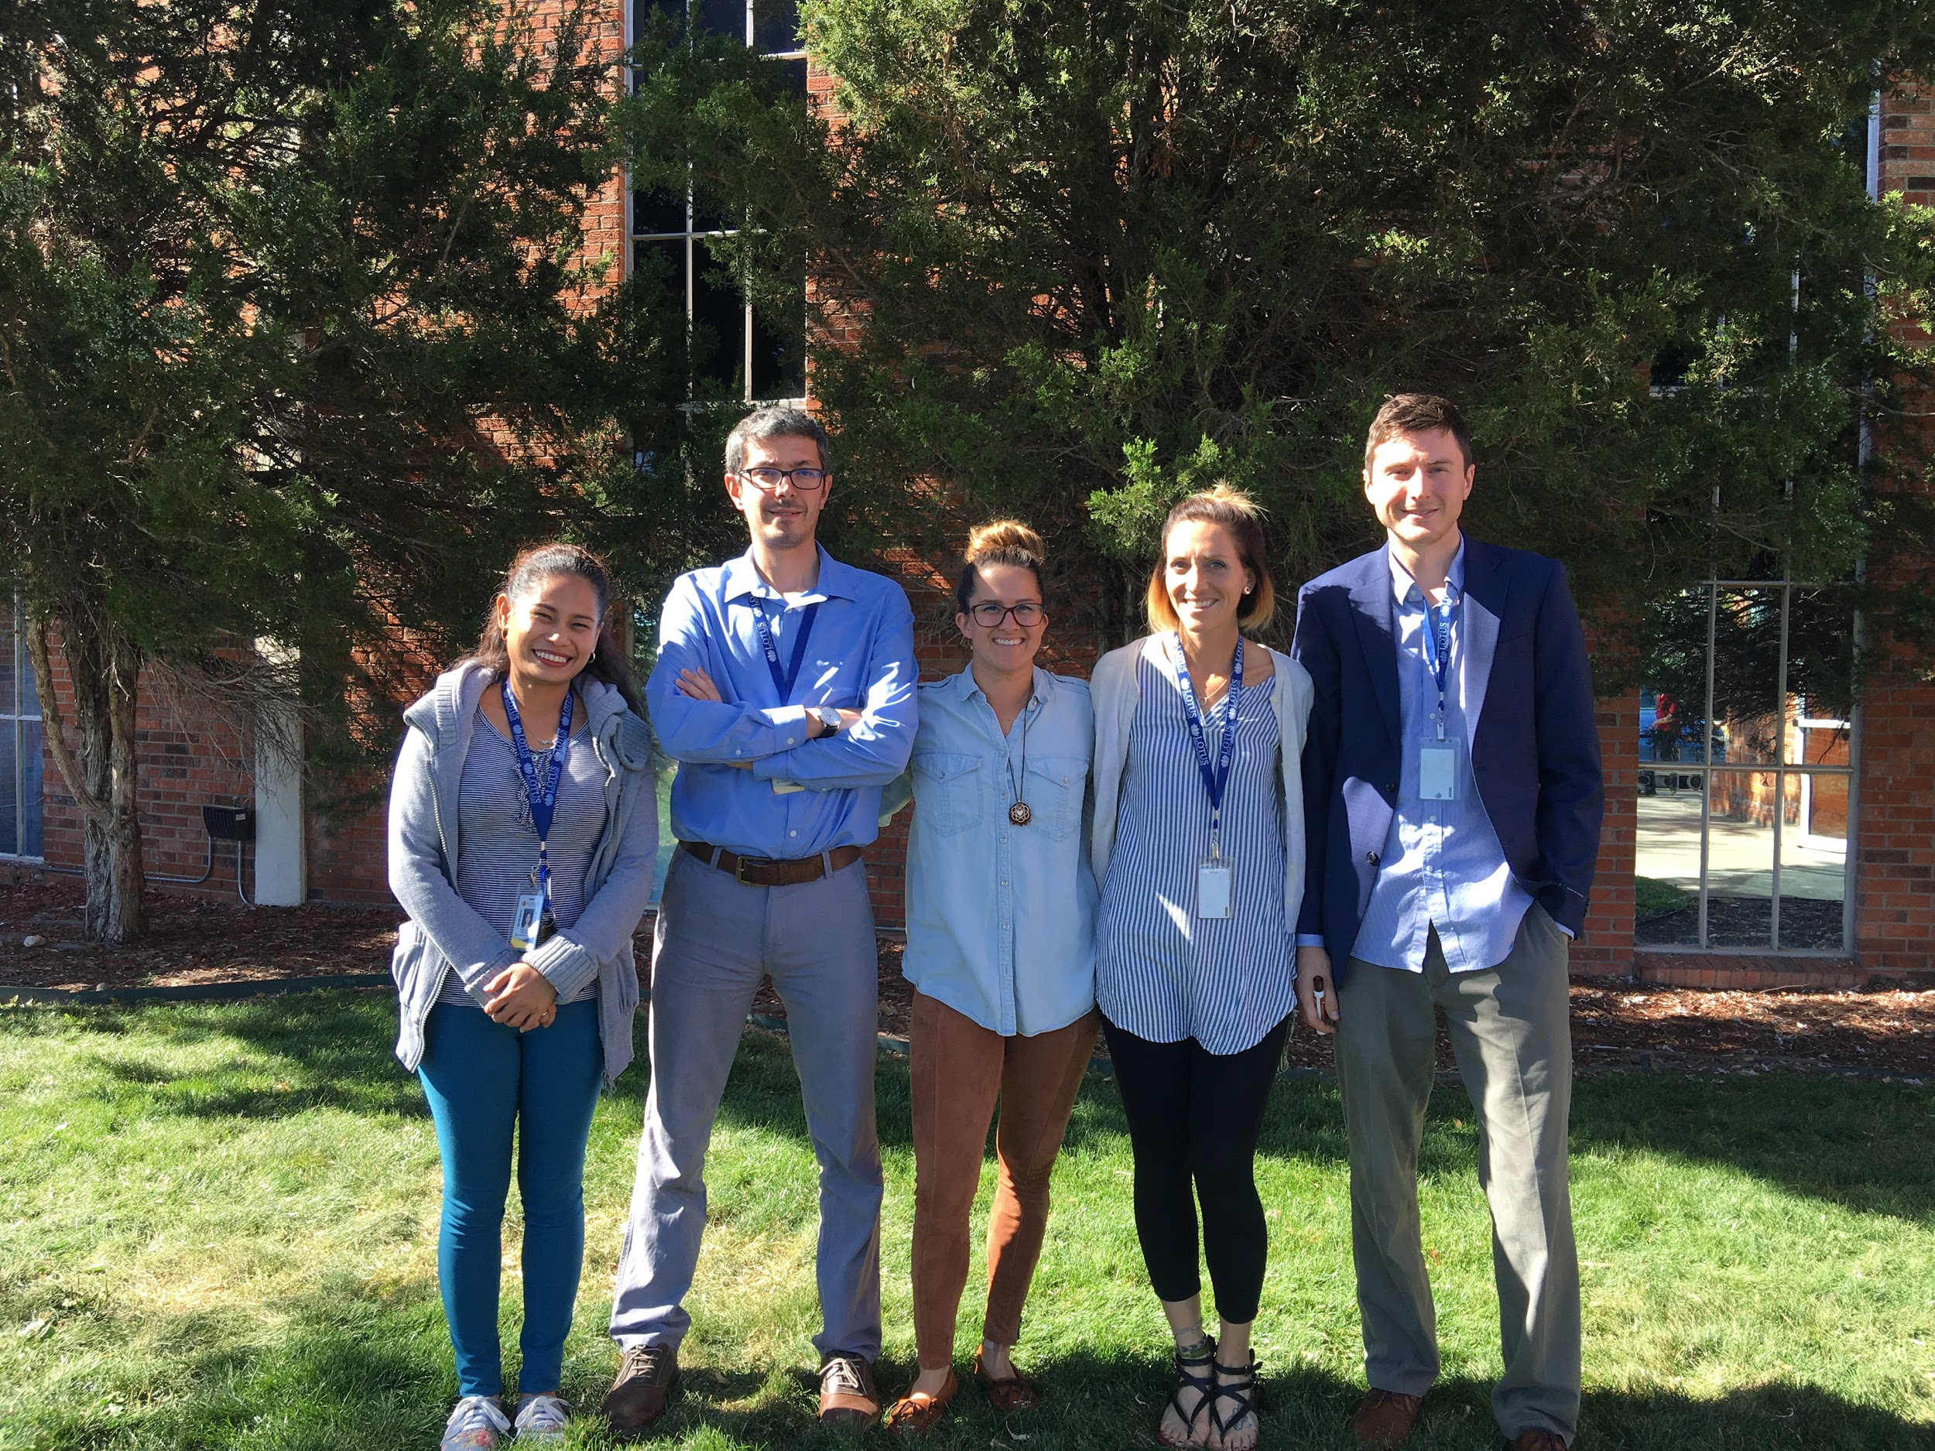
Lotus School for Excellence
Amazing Diversity -
Over 40 Countries
46 Different Languages Spoken

Slide 4
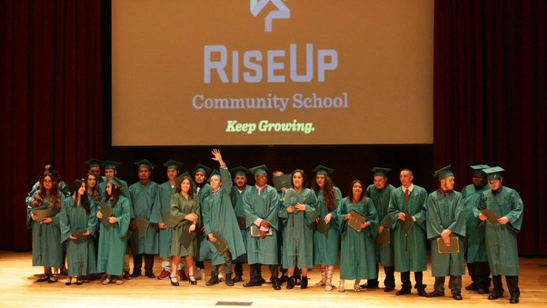

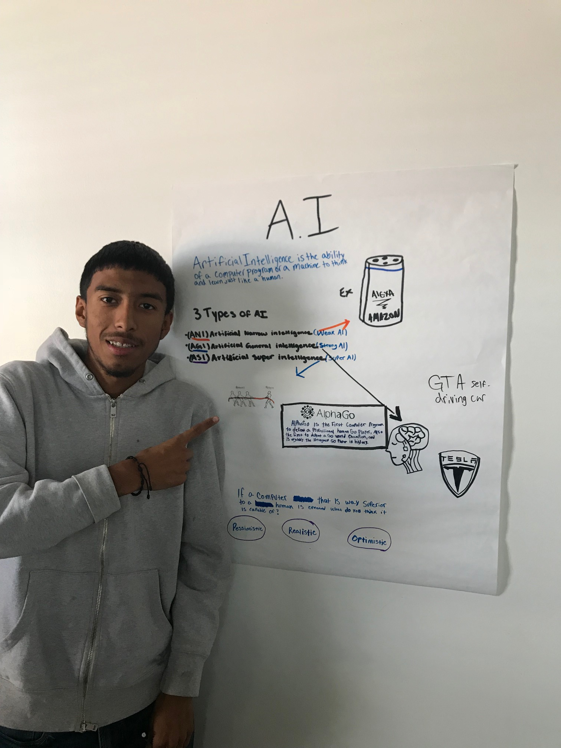
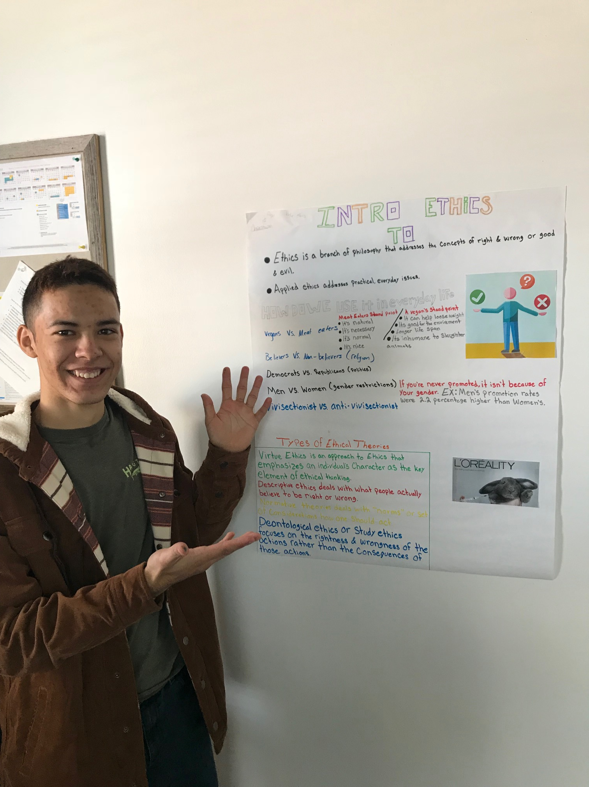

Rise Up Community School in Denver

Slide 5

Go to google classroom and open A.I. Ethics notes - under assignments.
Then On Your Notecard….
Tell me a story!
Just as I shared my story about how I got here, tell me a life story that will help me understand you and your personality better. It can be anything you feel comfortable sharing.

Slide 6
General Preview of This Course
This course is yours just as much as it is mine! You will help me create it.
Monday | Tuesday | Block | Friday
1/20 MLK No School | 1/21 Topic: Intro Myself & Kids / Fourth Industrial Revolution Day 1 Presentation Kurzegat Video | 1/22-23 Topic: Virtue Ethics Gray Area Project | 1/24 Topic: Topic: A.I. Future Outcomes Positive / Neutral / Negative Undone Story Undone Activity
1/27 Topic: The Basics of A.I. Functionality Perception Data Collection | 1/28 Topic: Ideas? A.I. Application (new) Per. 8 A.I. Court Case Project (new) Per. 7 A.I. Ethical Dilemma (old) Presentation Per. 1 A.I. Ethical Dilemma | 1/29-30 Topic: Continue Project Actively Help Guide Students Encourage specific outcomes around U.B.I. / A.I. Relationships / Autonomous Agents in Court | 1/31 Topic: Present Projects Wrap Up Discussion Goodbye & Thank You!

Slide 7
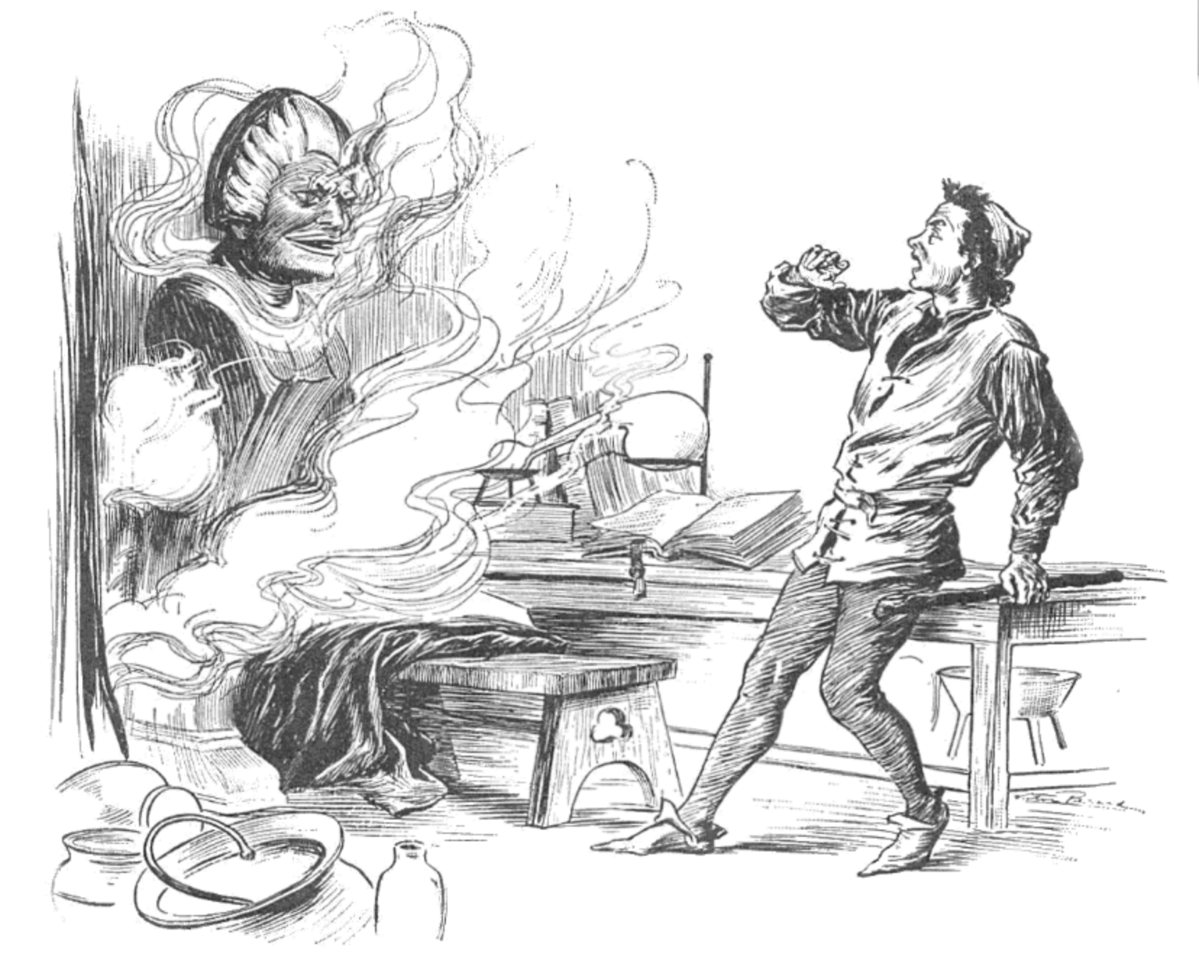

Story of the Brazen Head

Slide 8
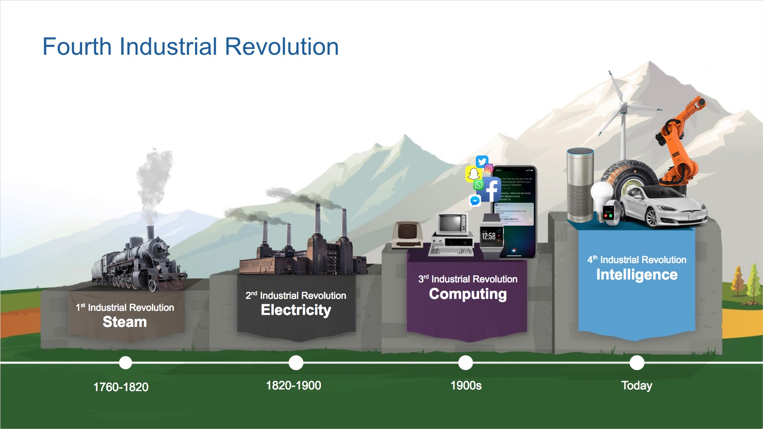
Welcome to the Fourth Industrial Revolution!
What are the similarities between these objects in the “today” column?
Welcome to the Fourth Industrial Revolution!
Why do we use machines?
What are we trying to do with them over time?
Mass Production

Slide 9

Why is the Fourth Industrial Revolution different?
Why is Matt here teaching us this?
Notes:
2004 Blockbuster CEO - 9mil Worth
2016 Netflix CEO - 23mil Worth

